Slide 1
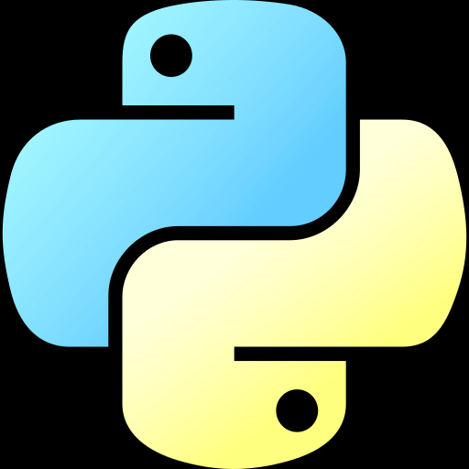
Python
Mahmudul Haque Joy

Slide 2
Content
What is Programming?
Basics of Python.
Installation process of python
Installation process of VS Code
Basic Components of Python
What is keyword?
What is variables?
Rules of Identifiers
What is Data type?

Slide 3
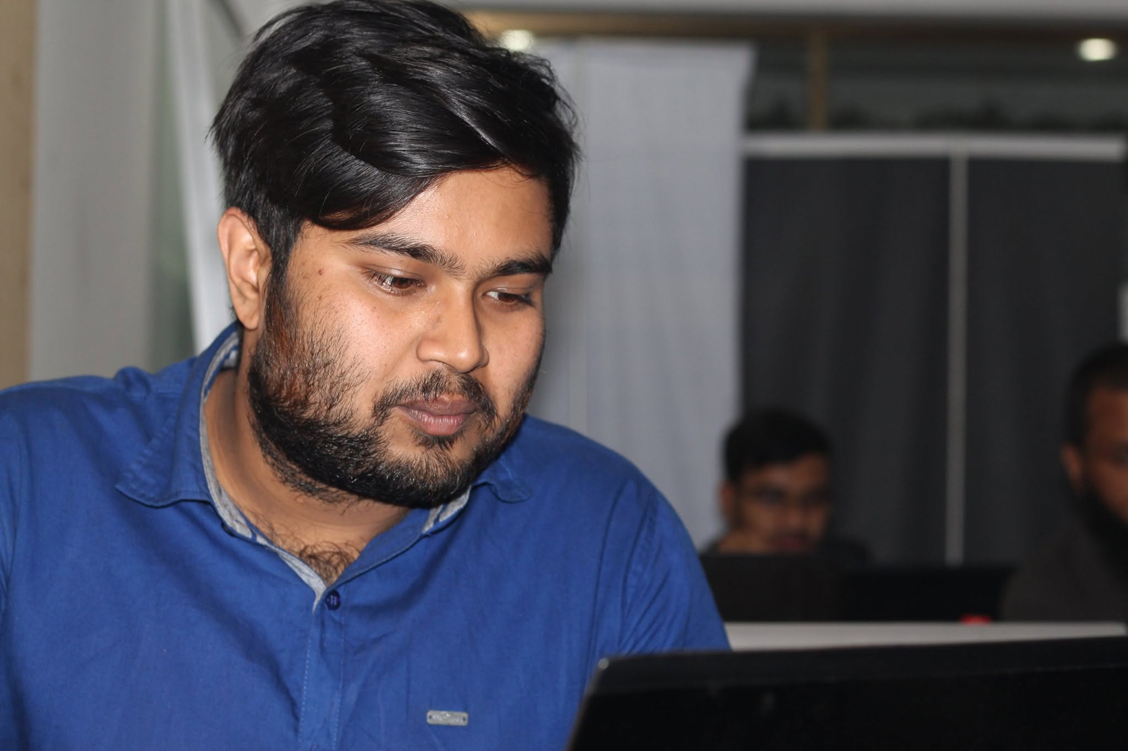
About Me
Educational Background
Rangpur Zilla School – 2013
Rangpur Govt. College – 2015
Bangladesh Army University of Science & Technology – CSE - 2019
Professional Background
Trainee Game Developer, Advanced Mobile Apps & Games Development Project, ICT Division
Jr. Associate, Daraz Bangladesh Limited.
IT Instructor/ Support Engineer, Bangladesh Army
AI/ML Engineer, Smart Code Bangladesh Limited.
Research Background
MI-Task Classification Using Logistic Regression and Filter Bank Common Spatial Pattern

Slide 4
What is Programming?
Programming is the process of creating instructions that tell a computer/System what to do. These instructions are written in a programming language such as Python, Java, C++, or JavaScript.
For this course we will use : Python.

Slide 5
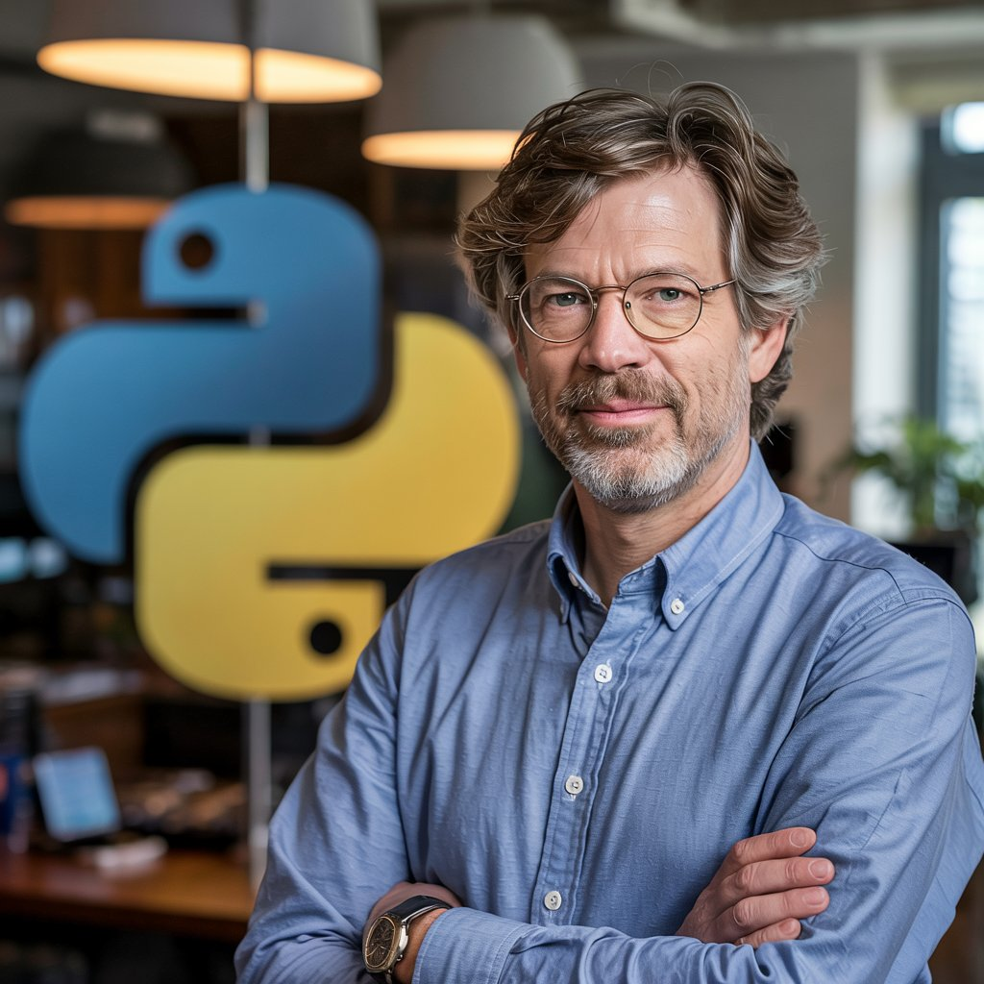
Basic Info About Python?
Created By: Guido van Rossum
First Release: 1991
Compilation Type: Interpretation
Language type: High Level Language
Current Release: 3.14

Slide 6
Frameworks & Packages of Python We Need
NumPy – Numerical computing
Pandas – Data manipulation
Matplotlib – Data visualization
Plotly – Interactive charts
scikit-learn
PyTorch
Tensor
FlowKeras
OpenCV
YOLO
Albumentations
Transformers
Hugging Face ecosystem
spaCy
NLTK
LangChain
LlamaIndex
vLLM
Ollama
Django/Fast API
Jupiter Notebook

Slide 7
Other Things We Need To Become A Jr. Developer
HTML
CSS3
Bootstrap
JavaScript
React JS/Vue JS
Docker
Linux
NGINX
Redis
PostgreSQL/MySQL

Slide 8
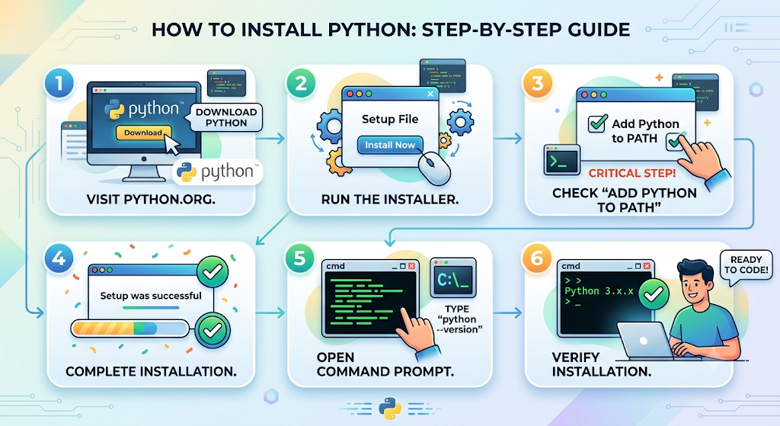

Slide 9
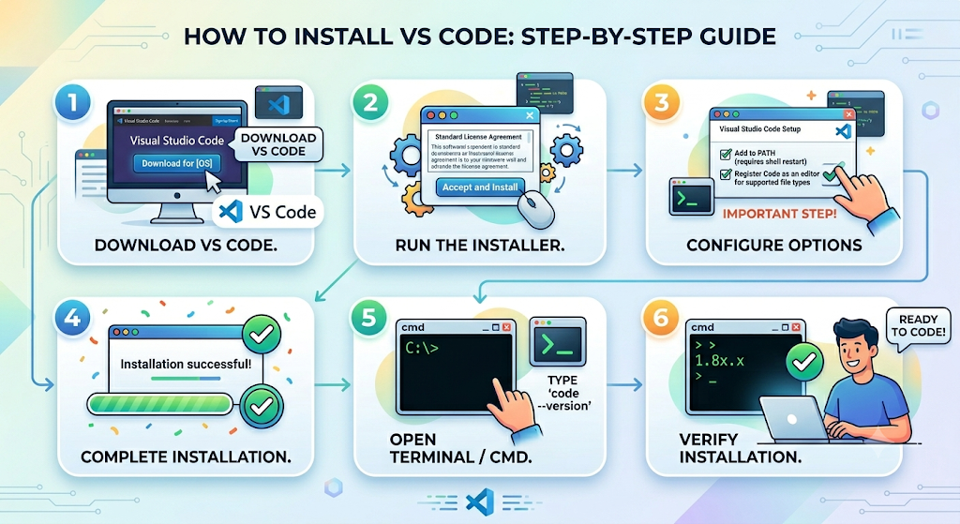

Slide 10
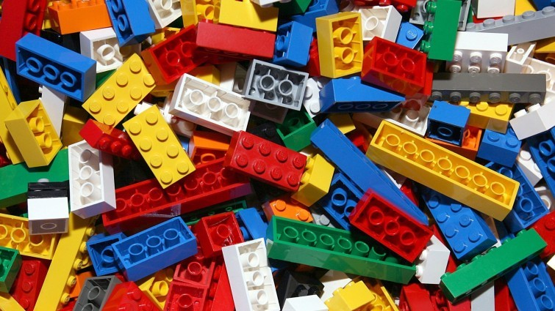
Basic Components of Python
Keywords
Variables
Data Types
Operators
Input/Output
Conditional Statements
Loops
Functions
Lists, Tuples, Dictionaries, Sets
Modules & Libraries
Classes & Objects

Slide 11
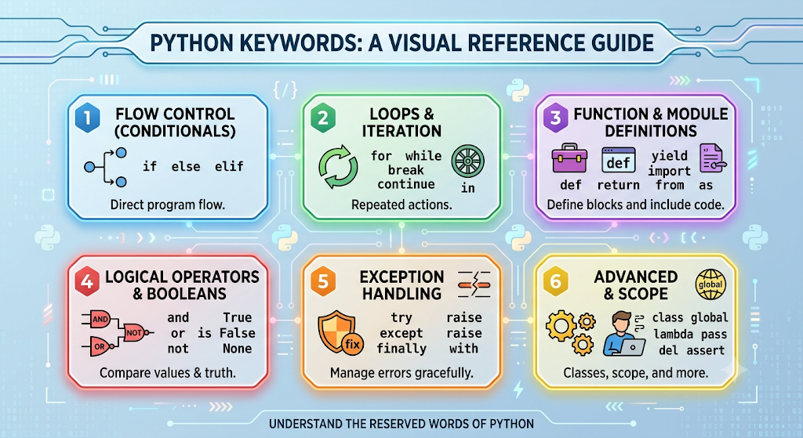
What is Keyword?
A keyword is a reserved word in Python that has a predefined meaning and purpose. Python uses keywords to define the syntax and structure of programs.
Example: class, for, if, in
Total no of Keywords in python 3.14 Version: 35

Slide 12
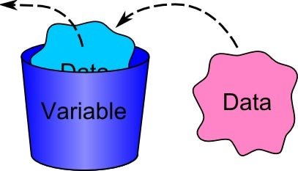
What is Variable?
A variable is a named storage location that holds a value. Think of it as a labelled box: the name is the label, and the value is what you put inside the box.
Python creates the variable when you first assign a value.
The variable points to that value.
You can change the value later.

Slide 13
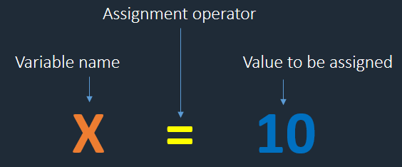
Rules of Identifiers
Must start with a letter or underscore.
Cannot start with a digit.
Cannot be a Python keyword (if, for, class, etc.).
Are case-sensitive (age, Age, and AGE are different variables).

Slide 14
What is Data Types?
A data type defines the kind of value a variable can store and the operations that can be performed on that value.
Examples:
name = "Joy" # String
age = 25 # Integer
height = 5.8 # Float
is_student = True # Boolean
Data Type
Numeric
String
Boolean
Integer
Float
Complex
Sequence
Tuple
Set
List
Range
Dictionary
None

Slide 15
Comments
Python has commenting capability for the purpose of in-code documentation.

Slide 16
Resources you can use
W3Schools
Programiz
Codecademy
freeCodeCamp
Real Python
GeeksforGeeks
Kaggle

Slide 17
Q&A

